Slide 1
Energy Efficient Concept Drift Adaptive Learning
Eva García-Martín
eva.garcia.martin@bth.se

Slide 2


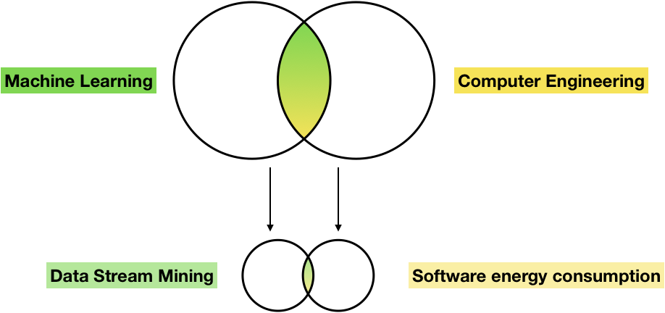
Thesis
Make Machine Learning algorithms more energy efficient

Slide 3


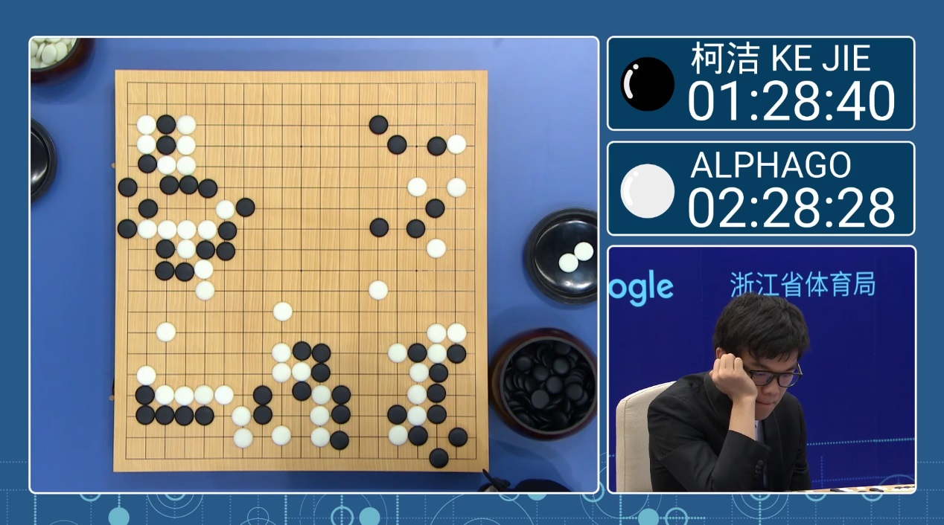
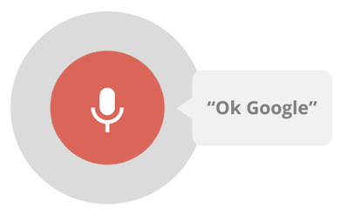

Machine learning
Algorithms that automatically learn with experience

Slide 4
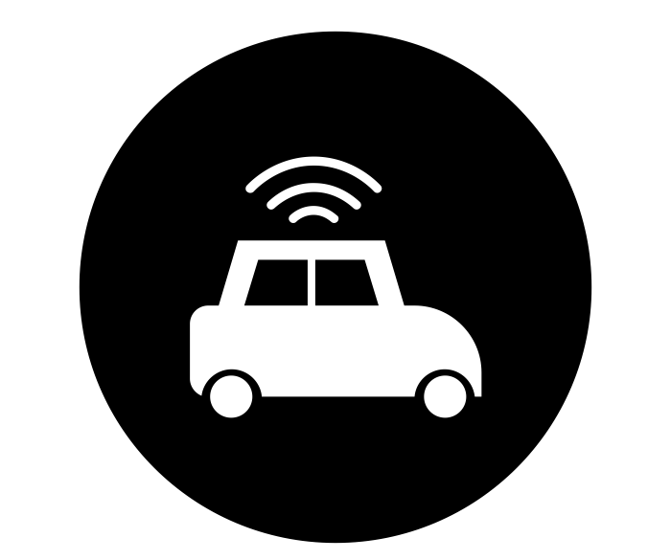
Data stream mining
How can one learn from data and process evolving data in only one pass?
Real-time
Computationally efficient

Slide 5


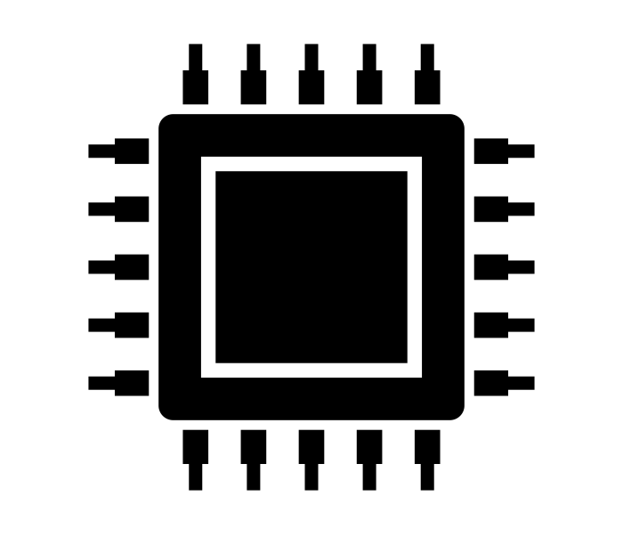
Energy efficiency
Reduce the energy consumption of computer programs
How?
  Less memory accesses
  Less computations

Slide 6



motivation
Machine learning algorithms consume significant amounts of energy
Environmental impact
Challenging to run on-device machine learning models
Emerging trend to make energy efficient machine learning algorithms, e.g. TensorFlow Lite

Slide 7
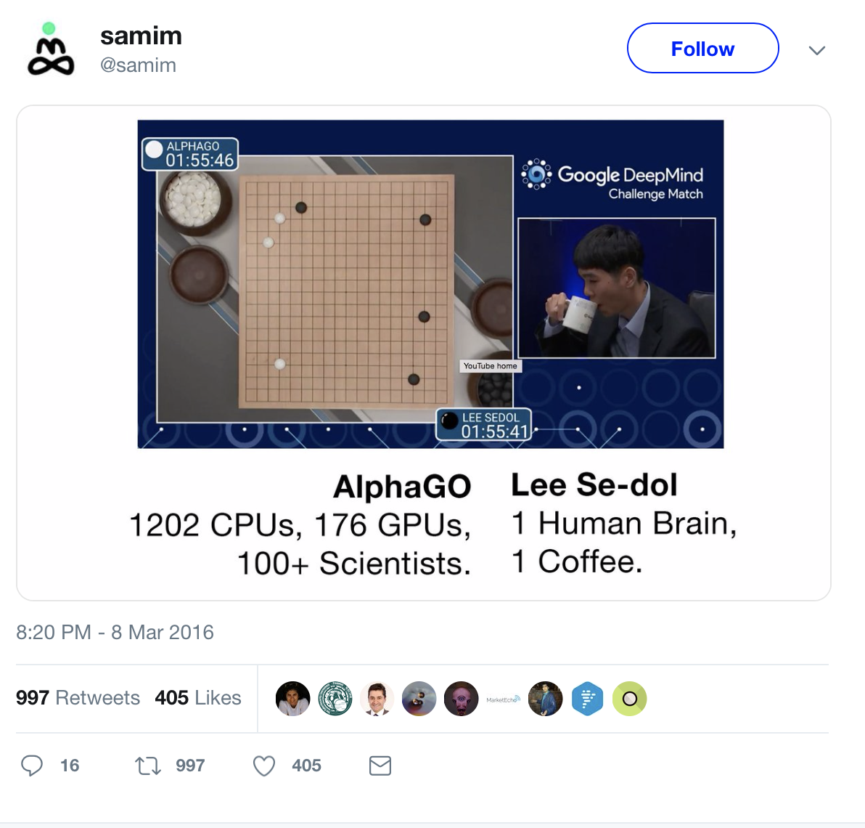
MOTIVATION

Slide 8
State-of-the-art
data stream mining
Hoeffding Tree (HT) (2000)
Pedro Domingos and Geoff Hulten. 2000. Mining high-speed data streams. In Proceedings of the sixth ACM SIGKDD international conference on Knowledge discovery and data mining (KDD '00). ACM, New York, NY, USA, 71-80.
Hoeffding Adaptive Tree (HAT) (2009)
Bifet, Albert, and Ricard Gavaldà. "Adaptive learning from evolving data streams." International Symposium on Intelligent Data Analysis. Springer, Berlin, Heidelberg, 2009.
Extremely Fast Decision Tree (EFDT) (2018)
Manapragada, Chaitanya, Geoffrey I. Webb, and Mahsa Salehi. "Extremely fast decision tree." Proceedings of the 24th ACM SIGKDD International Conference on Knowledge Discovery & Data Mining. ACM, 2018.

Slide 9
State-of-the-art
data stream mining
Hoeffding Tree (HT) (2000)
  Online decision tree
  Constant time per example
Hoeffding Adaptive Tree (HAT) (2009)
  Concept drift handling
Extremely Fast Decision Tree (EFDT) (2018)
  High accuracy
  High energy consumption

Slide 10
Hoeffding trees

Slide 11
Hoeffding trees
Calculate the best attributes
If there is a confident split split

Slide 12
Hoeffding trees

Slide 13
Hoeffding adaptive tree (HAT)
Extension of the Hoeffding Tree algorithm
Concept drift detector
Creates an alternate tree when concept drift is detected
When the alternate tree is better, we substitute it for the original tree
Concept drift = Change in the data points

Slide 14
Hoeffding adaptive tree (HAT)
Challenge?
High energy consumption to be able to handle concept drift (2X more energy)

Slide 15
EXTREmely fast decision tree (EFDT)
Extension of the Hoeffding Tree
Higher accuracy
Higher energy consumption
Build the tree with a less restrictive splitting criteria, reevaluation of the splits later on

Slide 16
Goal
Propose the Green Hoeffding Adaptive Tree (GHAT) algorithm
Extension of the HAT algorithm
Concept drift adaptation
Low energy consumption

Slide 17
Our method
Most visited nodes EFDT criteria
Less visited nodes Deactivate them
Apply to the HAT algorithm as the baseline

Slide 18
Our method
Reduce the energy consumption and maintain accuracy by applying the EFDT criteria to just a set of the nodes

Slide 19
Research questions
Does the GHAT reduce significantly the energy consumption compared to the HAT algorithm?
Does GHAT obtain competitive accuracy results compared to the HAT algorithm in datasets with and without concept drift?
How much more energy is consumed with the GHAT compared to the standard HT algorithm?
What is the accuracy comparison between the GHAT and the EFDT (Extremely Fast Decision Tree algorithm), the latest HT extension?

Slide 20
Research questions
Goal: To see how well GHAT performs compared to HAT, HT, and EFDT
In terms of accuracy and energy consumption
Considering concept drift scenarios

Slide 21
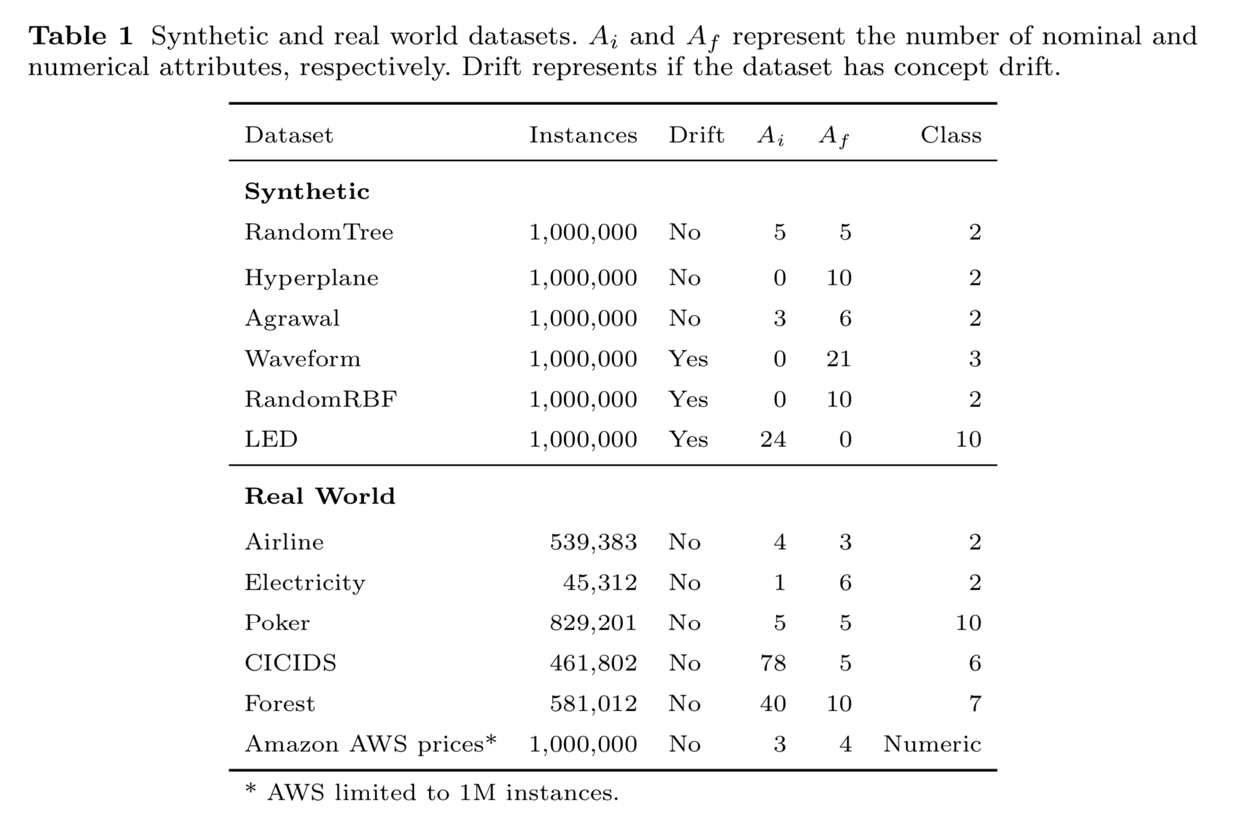
Datasets

Slide 22
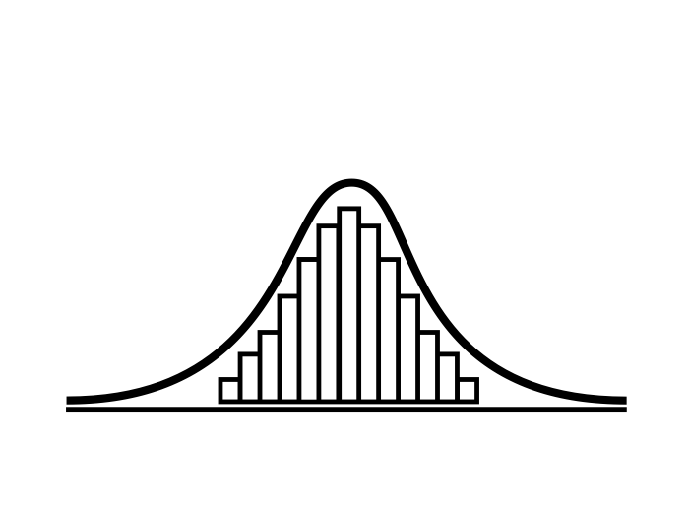
Data analysis
Normality test on the data
If data is normal Parametric tests
If data is not normal Non-parametric tests
Test if the comparison between energy consumption and accuracy are statistically significant

Slide 23
Environment
Algorithms: Massive Online Analysis (MOA)
https://moa.cms.waikato.ac.nz
Energy consumption (CPU, DRAM): Intel Power Gadget
https://software.intel.com/en- us/articles/intel- power- gadget- 20

Slide 24
Expected outcomes
Accuracy
Energy
Number of nodes
Number of leaves
Number of inactive leaves
Number of active leaves
Number of nodes with the EFDT criteria (fast nodes)

Slide 25
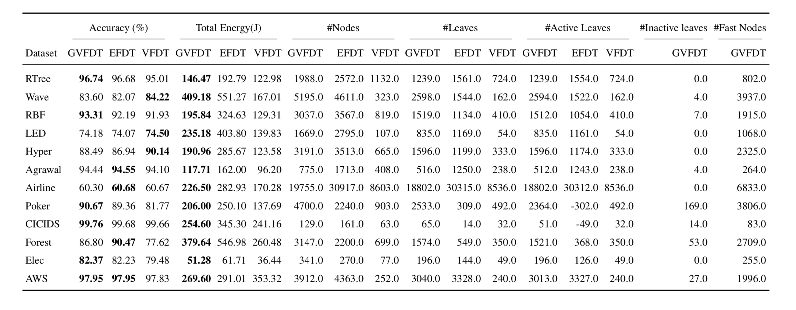
Expected outcomes *
* Taken from a previous paper Green Very Fast Decision Tree. Same method on the Hoeffding Tree

Slide 26
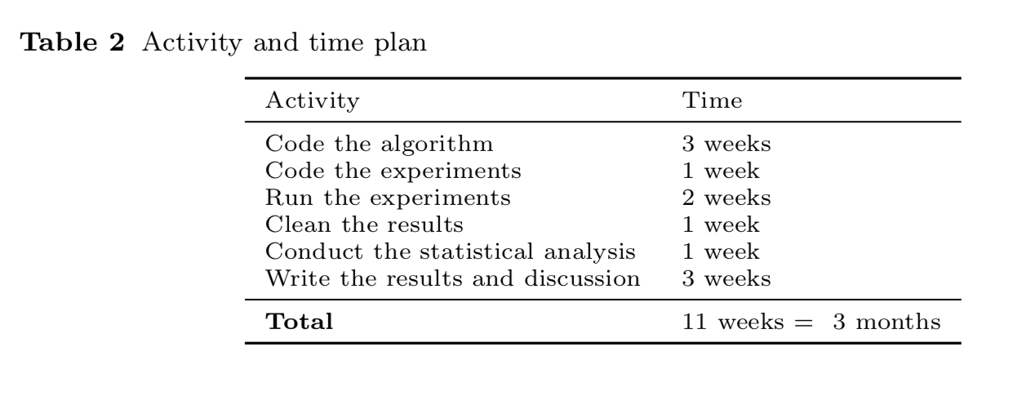
Activity plan

Slide 27

conclusions
Propose the Green Hoeffding Adaptive Tree algorithm
Extension of the Hoeffding Adaptive Tree algorithm, using the criteria from the EFDT on a set of nodes
Reduced energy consumption
Maintain levels of accuracy
Handle concept drift

Slide 28
Eva García-Martín
PhD Student in Computer Science
eva.garcia.martin@bth.se
https://egarciamartin.github.io

