Slide 1
On migrating from monolithic to cloud-native: An industrial multi-perspective investigation
Lakmal Silva

Slide 2
LakmAL SILVA
Software Architect/Team Lead
PLEng Candidate (~1 year)
M.Sc. Signal Processing/Telecommunication Systems
B.Sc. Computer Engineering
Experience
3 years as a Systems Engineer @LankaCom
11 years in multiple roles @Ericsson
Designer/3rd line support/Architect/Team Lead
Operations Support System(OSS)
Distributed systems
Cloud Management Systems
Multi vendor cloud management
Software Defined Networks(SDN)
Physical Network function(PNF)/Virtual Network Function (VNF) Orchestration
Contact: ruwan.lakmal.silva@ericsson.com / lks@bth.se

Slide 3
Industry trends
Cloud transformation of Telecom industry
Increased pressure to lower operational costs
Agile Operators

Slide 4
Demands on Software organizations
Continuous and fast delivery of customer value in short and long term.
Software architecture as a key driver for :
Efficient system evolution
Minimize maintenance efforts

Slide 5
research area
Large software systems with focus on System evolution:
Architecture
Monitoring
Maintenance
System Characteristics
High degree of component reuse
Blend of legacy systems

Slide 6
Study 1
An empirical study on a large telecom system
An experience report
Built reusing existing systems
Monolithic in nature
Utilized functionality (20%-30%)
Redundant functionality
Not built for cloud

Slide 7
ShoRT TERM VS LONG TERM
Strategies
Increase reusability of systems
Preserving investments of many years of tuning and debugging
Short term Benefits
Faster development, reduced time to market
Known software architecture, infrastructure, and domain knowledge
Long term Challenges and debts
Interoperability between legacy products
Integrating reuse practices into the development process
The deployment of new services into cloud environments
Scalability issues

Slide 8
System architecture
Northbound
Northbound
Northbound
Authentication
Authorization
Accounting
Authentication
Authorization
Accounting
Authentication
Authorization
Accounting
Logging
Logging
Logging
Product specific features
Product specific features
Product specific features
Southbound
Southbound
Southbound

Slide 9
STUDY 1: IDENTIFIED Challenges
Interoperability of legacy and new services
Mixing legacy systems created interoperability issues /Protocol conversions
Development process for system reuse
DevOps is not efficient due to the characteristics of the reused subsystems
Deployment and orchestration of services
Issues related virtual/cloud installation, monitoring, scaling of the system in virtualized and cloud environments

Slide 10
Study 2
In search for evidence of Architectural Technical Debt(ATD) from bug reports
Zoomed into one of the reused sub systems
Investigate architectural evolution over five years
Measure the impacts on Architecture using ATD
Has the system evolved to be better or worse?

Slide 11
System evolution over 4 releases
Release 1(2014-)
Release 2(2015-)
Release 3(2017-)
Release 4(2019-)
Characteristics
Monolith application
Last release of monolith
Hardware based deployments
Characteristics
Modularized application
First release of modular architecture
Components are running on own JVM
Hardware based deployments
Virtualized deployments
Characteristics
Modularized application
Last release of modular component architecure
Components are running on own JVM
Hardware based deployments
Virtualized deployments
Cloud deployments
Characteristics
Cloud native
Microservices
First release of cloud native architecure
Hardware based deployments
Cloud deployments
Bug Reports(509)
Category A: 7
Category B : 163
Category C: 339
Bug Reports(841)
Category A: 17
Category B : 269
Category C: 555
Bug Reports(945)
Category A: 6
Category B : 203
Category C: 736
Bug Reports

Slide 12
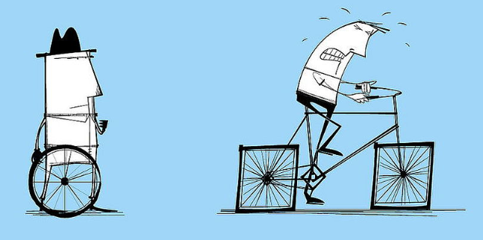
Architectural Technical Debt(ATD)
Immature architecture design artifacts that compromise systemwide quality attributes, particularly maintainability and evolvability.
ATD results from the compromise of modularity, reusability, analyzability, modifiability, testability, or evolvability during architecting.
Reuse of poorly designed legacy components instead of implementing their functionality from scratch
Achieve fast product delivery.
Such trade-offs made in architecture design may lead to architectural technical debt
https://melv1n.com/what-is-technical-debt/

Slide 13
Problems with ATD
Difficult to identify and measure
Can be invisible until:
Maintenance tasks are hard to conduct
New features are difficult to introduce
System quality attributes are challenging to meet
Lack of tool support(not easy to detect on code level)

Slide 14
Study Goals
How to identify ATD in a software system?
Viability of systematically looking at bug reports as a possible mechanism for ATD identification
Classify bug reports based on a set of definitions
Facilitate decision making in system evolution/architecting

Slide 15
Method
Identify ATD categories
Create definitions for ATD categries and sub categories
Classify bug reports by Architects and Senior developers
Distinguish between Architects’ view vs Developers’ view

Slide 16
ATD CATEGORIES
ATD
Dependency violations
Non-modulatiry
Compliance Violations
Change Proneness
Module dependencies
External Dependencies
Complex release processes
Contribute to dependency violation
Unstable
Interfaces
Implicit cross module dependency
Runtime dependencies
The presence of different design used to implement the same functionality
Violations of Ericsson Architecture guidelines
Different naming conventions applied in different parts of the system
Violations of design principles for a particular system
Unsound dependencies towards external services/libs
External Team Dependencies

Slide 17
an empirical study to test the classification framework
Pre selected set of Bugs ( A mixture of A, B and C) ~10/person
Bugs collected from System1 , System2 and System3(until 2019-04-04) : 2732 bug reports
Finding quality bug reports
Based on the amount of sentences in the “Observation” and the “Answer” sections
First sorted by most sentences to the least of the Answer section and then by Observation.
Read the Observation and Answer sections of the bugs.
Decide if the bugs can be categorized based on the previous slide.
If it’s not possible to classify, what are the missing information?

Slide 18
STUDY 2: LESSONS LEARNT
Results
Matching 6 out of 16 bugs by 2 participants(37.5%)
Difficult to map bug reports to ATD categories
Reguires Product/Domain expertise
Requires ATD category expertise
Difficulty in combining product/domain expertise with ATD category expertise
Bugs are not written and answered with ATD classification motive
Time consuming

Slide 19
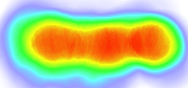
Study 3: NEXT STEPS
Natural language processing
Indirect mapping
System Architecture Documents
Natural Language Text
System Diagrams
Bug report
Answer:
CommitId
Bug report
Answer:
CommitId
Bug reports
Observation:
Answer:
CommitId
Architectural components
Source repositories
Source repositories
Source repositories
commitId trace to source code

Slide 20
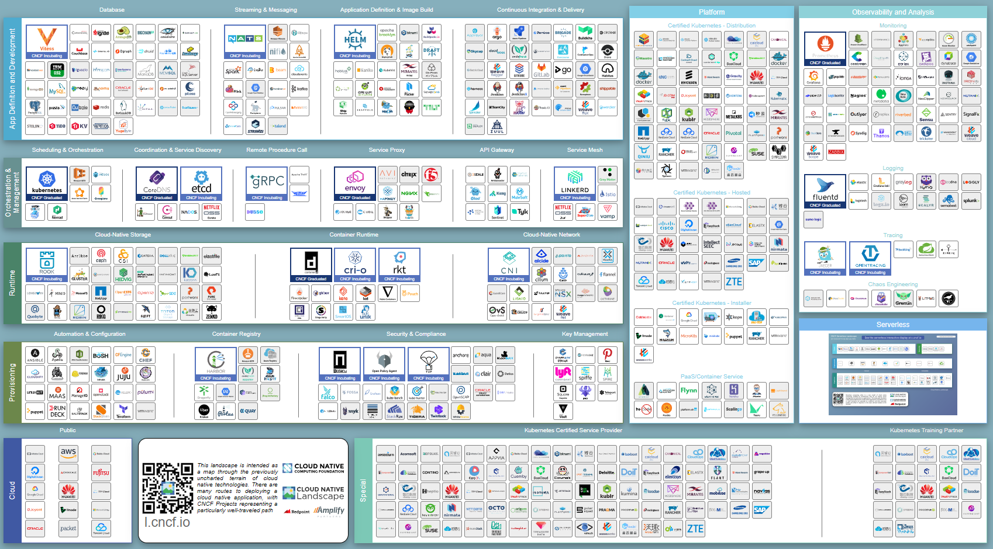
CNCF Cloud Native Landscape
https://landscape.cncf.io/

Slide 21
summary
What we have learnt
Reuse of monolithic systems provided short term benefits
Need for modularized Architecture
Direct mapping of bug reports to ADT is difficult
What we still want to know?
Has the Architecture evolved for better during different releases?
Short term goals
Triangulation with source code to architecture
Long term goals
State of the art - What literature say about cloud native migration?
State of practice – How Ericsson is migrating to cloud native?
Comparison of State of the art Vs State of practice

Slide 22
QUESTIONS
?

Slide 23
references
Silva, L., Unterkalmsteiner, M., & Wnuk, K. (2018, September). Monitoring and Maintenance of Telecommunication Systems: Challenges and Research Perspectives. In KKIO Software Engineering Conference (pp. 166-172). Springer, Cham.

