Slide 1
Scaling Agile through micro-refactoring of architecture and organization
Binish Tanveer
Blekinge Institute of Technology
2020-09-17
Notes:
Hello everyone, Thank you for the introduction. So I am working on Scaling agile. In this talk I would like to discuss How can we scale agile properly by taking both architecture and organization into account? Eventually enabling large organization’s ability to continuously refactor both in order to minimize waste and dependencies thereby retaining or creating the value

Slide 2
Scaling agile (the core problem)
Ways of working
Artifacts
Code
APIs
Repositories
Test cases
Requirements…
Assets
Teams
Tools
Models
Regulations
…
Notes:
Context – agile – scaling
Large organizations are aiming to continuously improve their competitiveness by increasing flexibility and shortening lead times.
The success of agile methods for small, co-located teams for this purpose has inspired these large organizations to adopt them as well
The use of agile methods in large teams and distributed development as well as in regulated environments has been perceived useful
Organizations that develop software intensive products and services have also been adopting agile methods for frequent delivery of working software
Such organizations usually have huge projects being executed by large and distributed development setting which require agile methods to be scaled
Consider here a non-scaled large organization – artifacts/assets and ways of working (connections) – is rather simple!

Slide 3
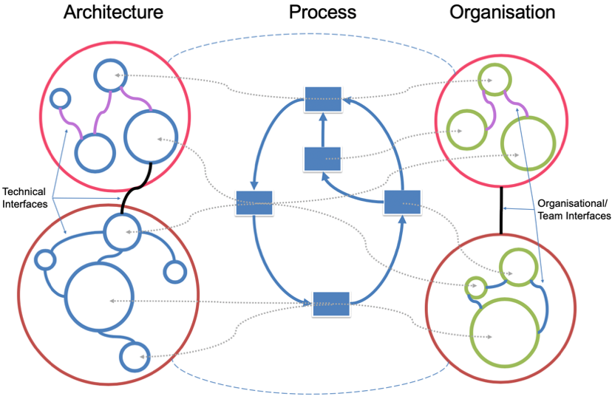
Ways of working
The scope, need and complexity of ways of working increase when organizations scale!
Every way is either generating value or producing waste.
Notes:
While scaling what happens!
Here: Observe when an organization scales, the scope and complexity of such connections also grows many folds. Such network of ways of working (OR connections)
increased inter-team coordination and communication,
increased dependencies between organizational units, and similarly
co-evolution of software architecture (in terms of dependencies on other subsystems and teams and aligning architectural improvements to business value).

Slide 4
Practical challenges
Ever growing dependencies making both organization and architecture over complex
  Change team structure and architecture in order to reduce coordination needs
Both architecture and organization influence each other
  Changing team structure influences architecture and changes to architecture have long-lasting consequences for an organization
Scaling methods (e.g. SAFe/LeSS) hampered by issues like the need to balance organizational structure, adherence to methods over value!
Notes:
How can team structure and architectural change in order to reduce coordination needs
This give rise to potential waste and inhibits to generate value (value eg = faster delivery and waste eg = increased cost or increased defects)
People have multiple tasks, context switches, code is not simple either …. The risk of introducing defects as waste is more and produce a low quality/ delayed software/service
Frameworks like (SCALe and LeSS tried to facilitate scaling however, their adaptation is facing issues plus they talk about adherence to frameworks than “value”)
Plus both Arch/Org influence each other! – no one has done before

Slide 5
Research gaps
Not considering refactoring of architecture and organization in a combination
Overlooking of value associated among dependencies between architecture and organization
  Increased risk of introducing waste through the dependencies than generating value
Lack of empirical evidence of scaling methods

Slide 6
Objective
To keep the architecture and organization simple in terms of keeping only those ways or connections that achieve more value (e.g. productivity, efficiency etc.) and removing the ones that introduce waste.
To choose the ways of working or connections in a cost-efficient manner.
To improve continuously.
How? -> Innovative idea
The idea is to do micro-refactoring of architecture and organization in a combination!
Notes:
Point: there is a need to control !
How can you make both sides simple, clean connections with increasing value and minimize the risk of introducing waste
What do we mean by micro-refactoring: Instead of refactoring architecture or organization separately, we would like to do it in a combination – that is something no one did it before!
Micro-refactoring (in terms of removing the unnecessary connections) – the term micro refers to doing refactoring in small steps and not in a big bang

Slide 7
Connection interfaces
Ways of working
Artifacts
Code
APIs
Repositories
Test cases
Requirements…
Assets
Teams
Tools
Models
Regulations
…

Slide 8
Micro-refactoring – an example
Architecture
Organization
Use Way 1 = documentation
  Both Person 1 and Person 2 use documentation instead of meeting
Use Way 2 = A meeting
  Person 1 and Person 2 meet to work on Component 1 and Component 2
Use Way 3 = Modularize the design
  Components are independent and Person 1, Person 2 have no meetings
Way =
Documentation
Comp 1
Person 1
Way =
Meeting
Comp 2
Person 2
Way =
Documentation
Deciding factor: Value/waste tradeoff analysis
Alternative ways are compared
Remove the ways that introduce waste
Notes:
We have to find whether meeting or documentation is more cost effective, efficient, satisfactory, trustworthy etc. any/all the value aspects OR in other words, which one introduces waste instead of value like wastes time, effort, non-productive etc as examples of waste
Then make an informed decision, so managers do not add ways to the existing ones, rather remove the unproductive alternatives

Slide 9
Research vision
To develop a framework that enables organizations
To micro refactor architecture and organization (in terms of ways of working).
Continuously measure the refactoring i.e. its impact on value/waste construct
Steps:
  Perform self-assessment of different ways of working in terms of value/waste constructs.
  Analyze the alternatives to the existing ways and utilize the most beneficial one in terms of value/waste.
  Refactoring (micro) of organization/ architecture
  Evaluate and measure the impact of refactoring on value/waste.
Assessment
Root cause analysis
Refactoring
Evaluation
Notes:
Using industry-academia collaboration model….the vision is to develop…
Part of the research is to find value/waste constructs in the light of state of the art and practice as well as the metrics to evaluate the process of refactoring itself as well as the outcome of the refactoring
Refactoring Architecture and Organization AND continuously measure how changes impact the interfaces (and amount, goodness of them)…. Seeing e.g. if a change gave better or worse results... same for changes to organization... or architecture...

Slide 10
Benefits
Long term
  Enable organizations to continuously change and improve
    In terms of identification and removal of waste
  Enable managers to take informed decisions
    Measure the impact of value/waste and remove the ways that generate waste
  Enable organizations to use the developed framework
    To perform assessments of existing complex network of ways and improve it
Short term
  Increased awareness and transparency
    of the existing ways of working and their alternatives through visualization.
  Availability of impact analysis of different ways
    on value/waste construct at any given point of time.
Notes:
Continous change and improvement
change and improvement impact analysis that gives evidence for if something works or not... identify waste and remove... through refactoring.... = REAL LEAN/AGILE
(so every time you add something you can use this as a "method" to figure out if you can/should remove something...) and/or
(you can overall look over the spaghetti and see if you can measure that (see the spaghetti) then simplify (remove spaghetti).

Slide 11
Questions
Ways of working
Notes:
While scaling what happens!
Here: Observe when an organization scales, the scope and complexity of such connections also grows many folds. Such network of ways of working (OR connections)
increased inter-team coordination and communication,
increased dependencies between organizational units, and
co-evolution of software architecture (in terms of dependencies on other subsystems and teams and aligning architectural improvements to business value).

Slide 12
Thank you!
Scaling Agile through micro-refactoring of architecture and organization
Binish Tanveer
bta@bth.se

